Slide 1

Secure 3-Tier Enterprise System AeroShield Dynamics Inc.
ISEC3080
Final Presentation
Christopher Jones
w0136969
April 8, 2025

Slide 2
About AeroShield Dynamics Ltd.
Advanced drone manufacturer for emergency services
Based in Halifax, Nova Scotia
Clients: Law enforcement, SAR, medical, infrastructure
Mission: Enhance emergency response with AI-driven UAVs

Slide 3
Project Overview & Objective
Goal: Implement secure, scalable 3-tier enterprise system
Tiers: Web, Application, Database
Focus: Security, scalability, and NIST/OWASP compliance

Slide 4
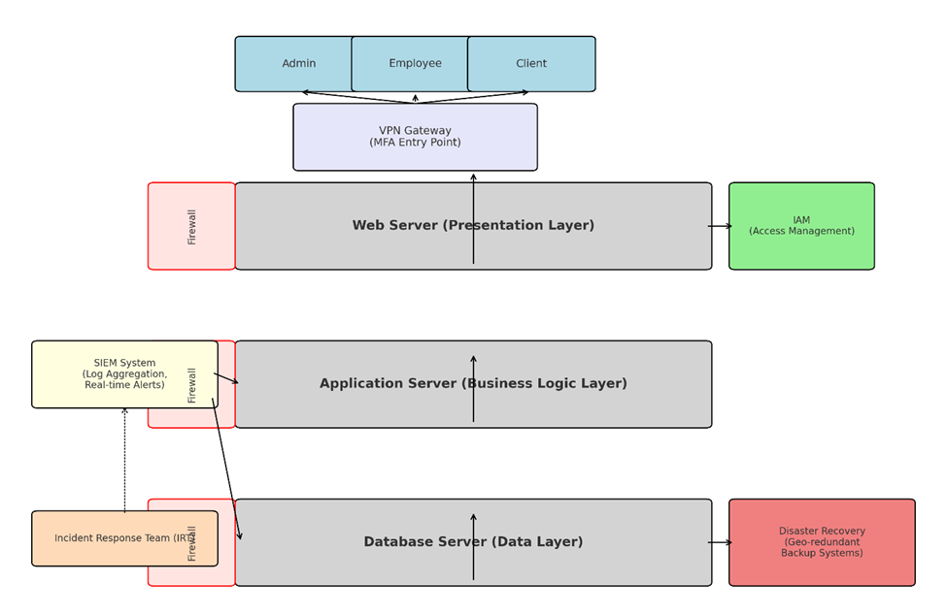
System Architecture

Slide 5
Statement of Work
Web Server: Employee/client portal
App Server: Order processing, production tracking
DB Server: Secure storage of critical data
Deliverables: Secure system, scalable design, DR plan

Slide 6
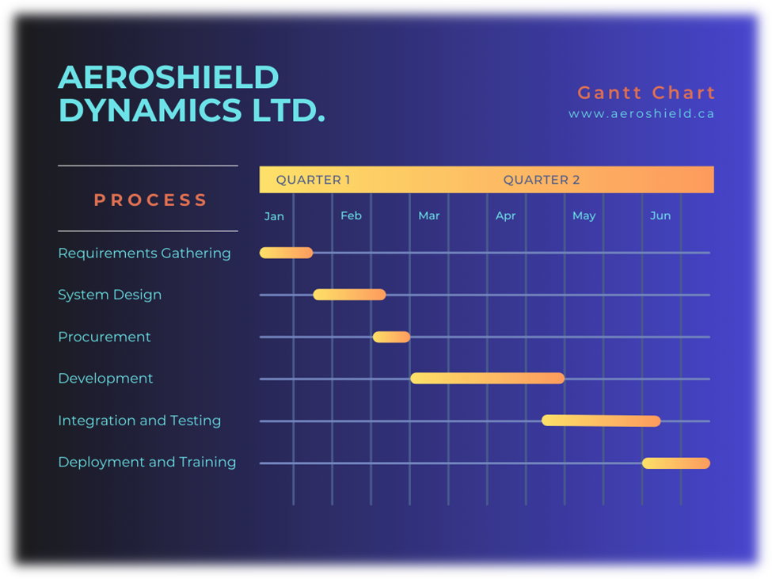
Timeline & Milestones
Phases:
Requirements,
Design,
Procurement,
Development,
Testing,
Deployment
Duration: 27 weeks total

Slide 7
Estimated Budget $2,155,000
Category | Cost
Hardware/Infrastructure | $1,300,000
- On-premises servers (Web, App, DB) | $150,000
- Networking equipment & storage | $150,000
- 500 laptops | $500,000
- 500 cell phones | $500,000
Software | $300,000
- Licensing (OS, database, middleware) | $200,000
- Development tools & IDEs | $100,000
Labor (6 months) | $435,000
- Project Manager (1 full-time) | $90,000
- Software Engineer (1 full-time) | $75,000
- Senior Developers (2 full-time) | $120,000
- Software Developers (2 full-time) | $100,000
- Contractors/Consultants (as needed) | $50,000
Miscellaneous | $120,000
- Training and documentation | $20,000
- Contingency fund | $100,000
Estimated Budget Total | $2,155,000

Slide 8
Resources & Team
Hardware:
Servers: 3 server tiers: Web, Application, and Database.
Storage: SAN storage with RAID 10 for redundancy.
Networking: Enterprise-grade switches, routers, and firewalls.
Backup Systems: Cloud or hybrid backup solution (Azure).
Software:
Web Server: Apache
Application Server: Middleware such as Node.js, Django, or ASP.NET.
Database Server: MySQL, PostgreSQL, or Microsoft SQL Server.
Security Tools: Endpoint protection, monitoring tools, and firewalls.
Personnel:
Project Manager: Oversee timeline and deliverables.
Software Engineer: Oversee system architecture.
Senior Software Developers (2): Supervise and work on more challenging development assignments.
Developers (2): Build and integrate application features.
System/Network Administrators (2): Configure servers, ensure security, and provide user support.
Contractors: External contractors as needed for vulnerability assessment, penetration testing, and quality control.

Slide 9
Security Overview
Authentication: OAuth2, MFA, RBAC
Encryption: AES-256 (data at rest), TLS 1.3 (in transit)
Monitoring: SIEM, alerts, IDS
Compliance: NIST SP 800-53, OWASP ASVS

Slide 10
Change Management Plan
Weekly CAB reviews
Categorization: Standard, Emergency, Major
Staging/testing before implementation
Logging, rollback, documentation

Slide 11
Testing Plan Highlights
Unit, Integration, Performance, Security, UAT
Tools: Jest, PyTest, Selenium, JMeter, OWASP ZAP
Continuous testing via CI/CD pipeline

Slide 12
Prototype Overview
Features:
React.js login portal
Node.js API with MFA and RBAC
PostgreSQL DB with encrypted sample data
Limitations: Localhost-only, scaled for 10-20 users
Next steps: AWS deployment, telemetry, user expansion

Slide 13
Risk Management Summary
Key Risks:
Data loss,
cyber threats,
knowledge gaps
Mitigation:
Backups,
RBAC,
structured handover,
testing

Slide 14
Conclusion
Demonstrated secure 3-tier system
Ready for production scaling
Focus on secure growth, telemetry integration, cloud ops

Slide 15

QUESTIONS?

